Slide 1
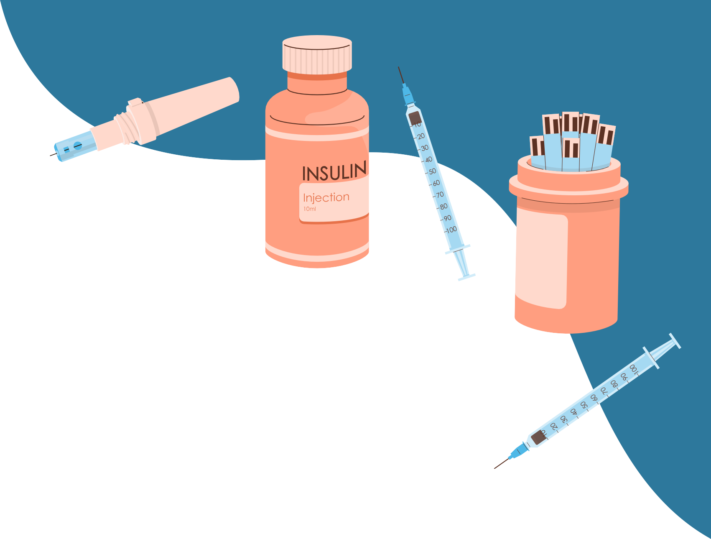
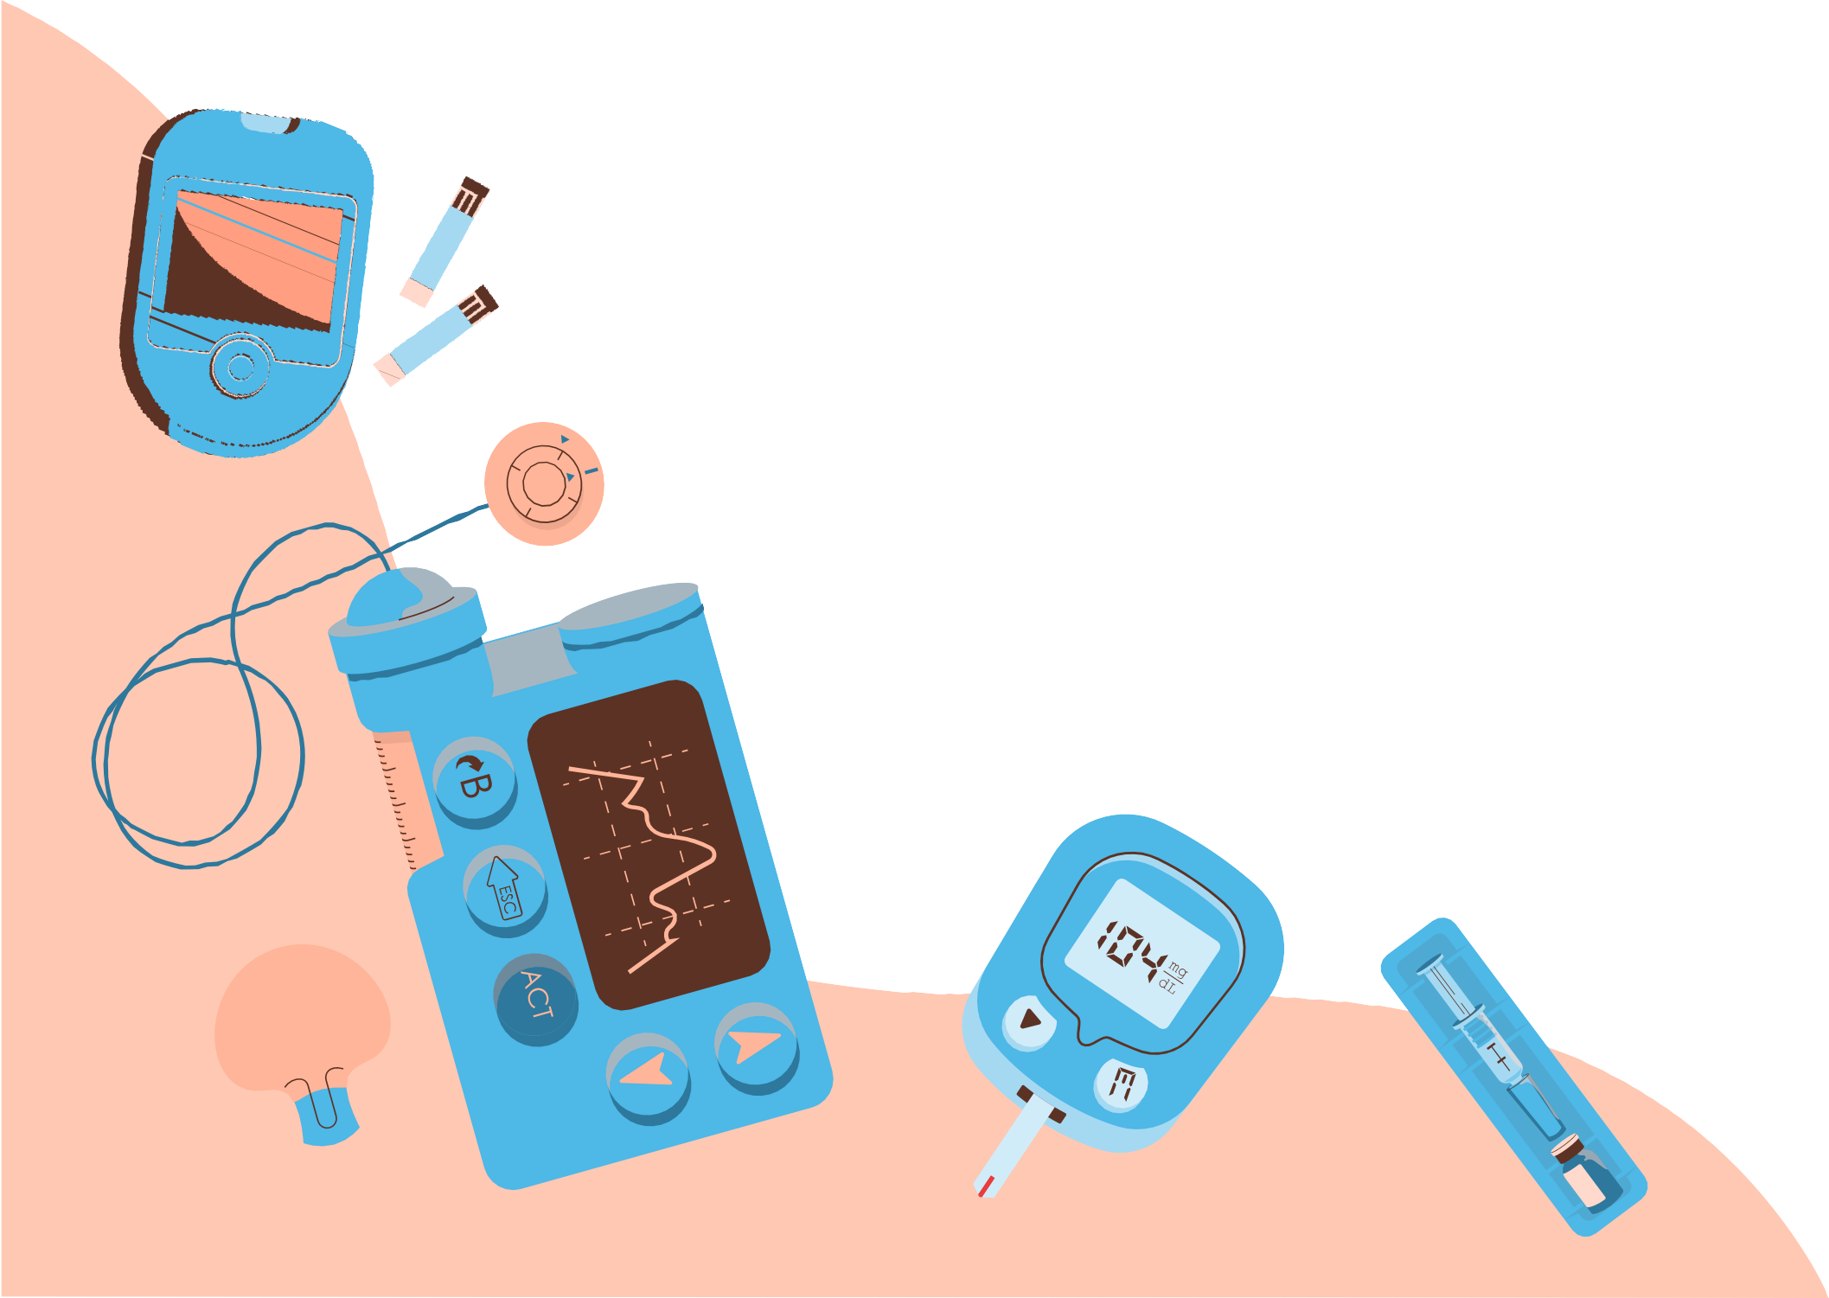
PREDICTIVE MEDICAL DIAGNOSIS OF DIABETES BASED ON PATIENT SYMPTOMS USING MACHINE LEARNING
RAGHED ISLEEM 1211326
SHAHED SHRATEH 1210444
FATIMA DAWABSHEH 1210827

Slide 2
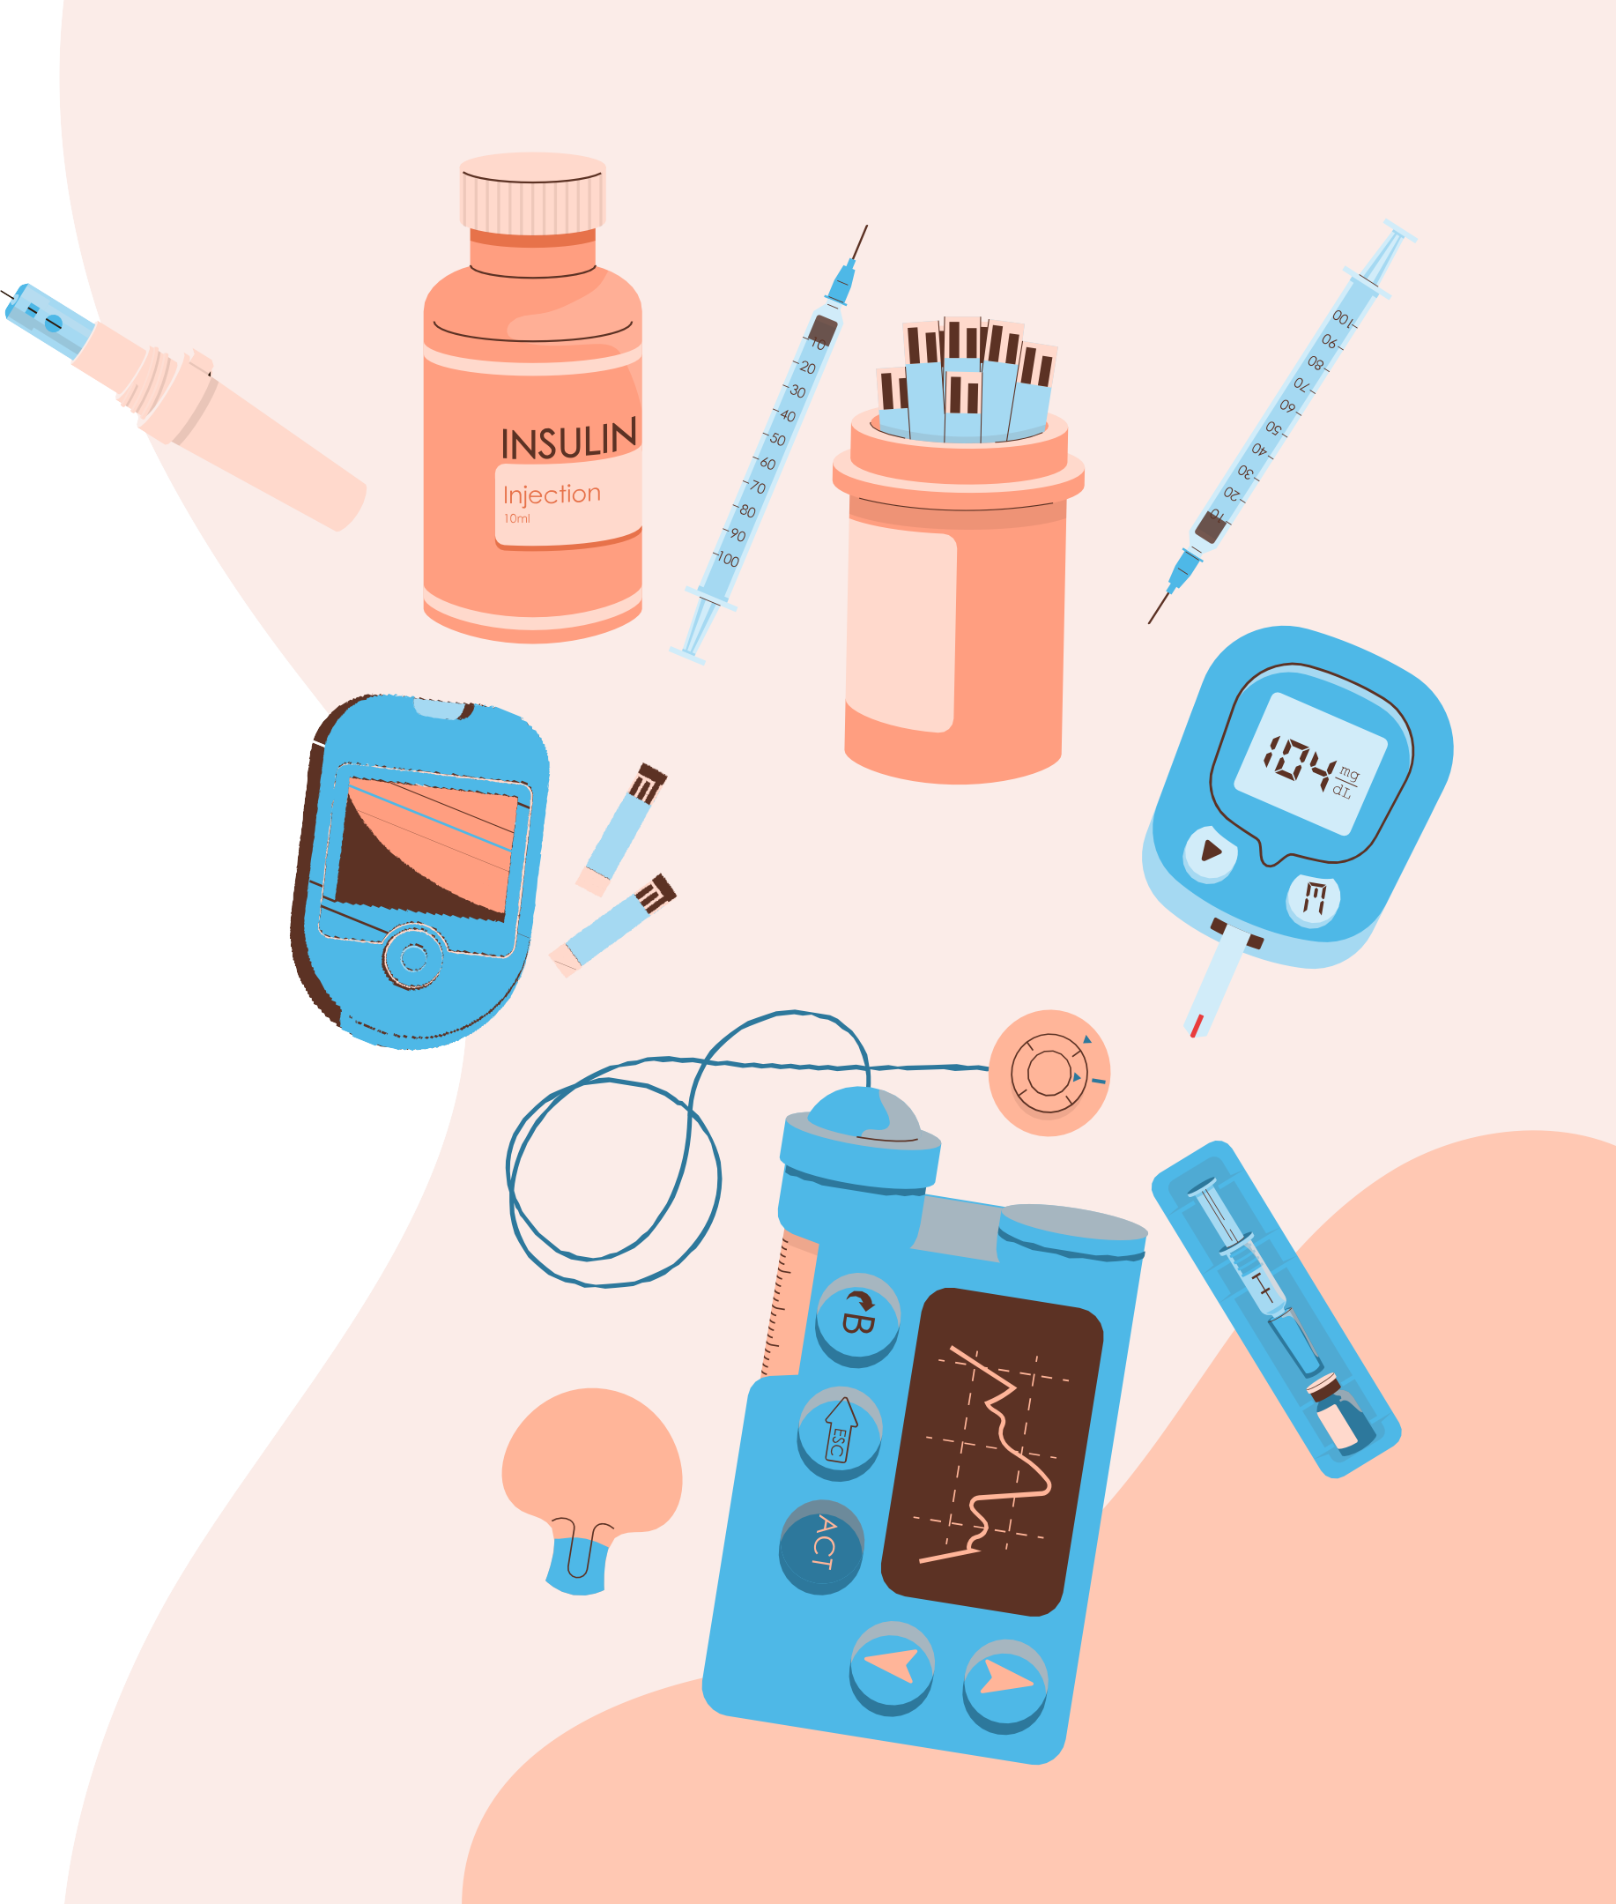

this project is a system we developed to assist with the medical diagnosis of diabetes using machine learning. Our system allows users to choose between two datasets, select a machine learning algorithm, and perform a test to determine if they have diabetes.

Slide 3
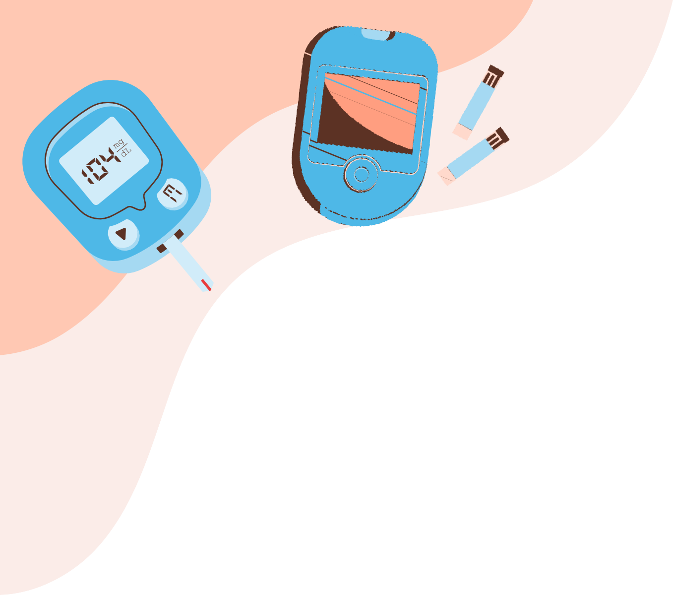
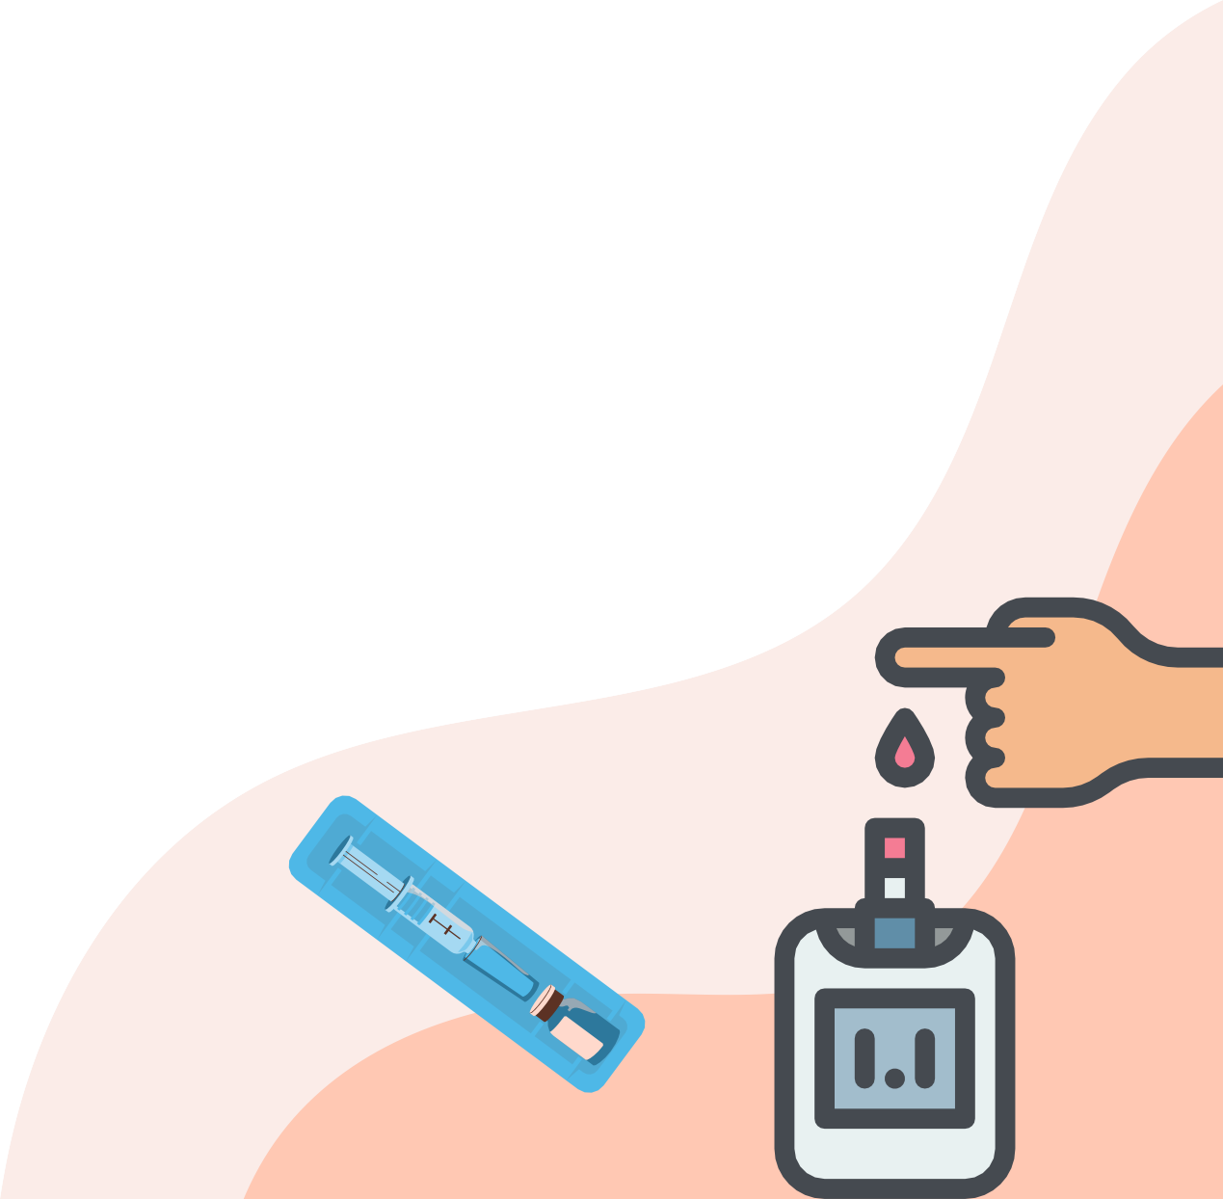
Throughout the demo, we'll explain how the system work, showcase what the algorithm we use, and test it with real-world inputs and explain the results.

Slide 4

HOW THE SYSTEM WORKS:
OUR SYSTEM IS DESIGNED TO LEVERAGE MACHINE LEARNING ALGORITHMS FOR MEDICAL DIAGNOSIS. USERS INTERACT WITH THE SYSTEM THROUGH A SIMPLE WEB INTERFACE. THEY CAN CHOOSE FROM TWO DATASETS, EACH CONTAINING DISTINCT ATTRIBUTES RELEVANT TO MEDICAL DIAGNOSTICS, AND SELECT ONE OF THE PROVIDED ALGORITHMS FOR ANALYSIS. THE SYSTEM PROCESSES THE DATA BY TRAINING THE SELECTED ALGORITHM ON A PORTION OF THE DATASET AND THEN EVALUATES ITS PERFORMANCE ON UNSEEN DATA, GENERATING RESULTS THAT INCLUDE METRICS SUCH AS ACCURACY, PRECISION, RECALL, AND F1-SCORE.

Slide 5

Machine learning is a method where a computer gets trained from data using different methods.
In this project, we classify using the decision trees, random forests, Naive Bayes, and neural networks, we optimize a classification model using the Weka program and Python. These algorithms provide different capabilities for finding relationships:

Slide 6

DECISION TREES: CREATE TREE-LIKE MODELS OF DECISIONS AND THEIR OUTCOMES, USEFUL FOR STRUCTURED CLASSIFICATION.
RANDOM FORESTS: COMBINES MULTIPLE DECISION TREES, IMPROVING ACCURACY FOR CLASSIFICATION AND REGRESSION.
NAIVE BAYES: USES PROBABILITY AND BAYES' THEOREM, EFFECTIVE FOR CLASSIFICATION TASKS.
NEURAL NETWORKS: DEEP LEARNING MODELS THAT LEARN COMPLEX PATTERNS, SUITABLE FOR ADVANCED CLASSIFICATION PROBLEMS.

Slide 7
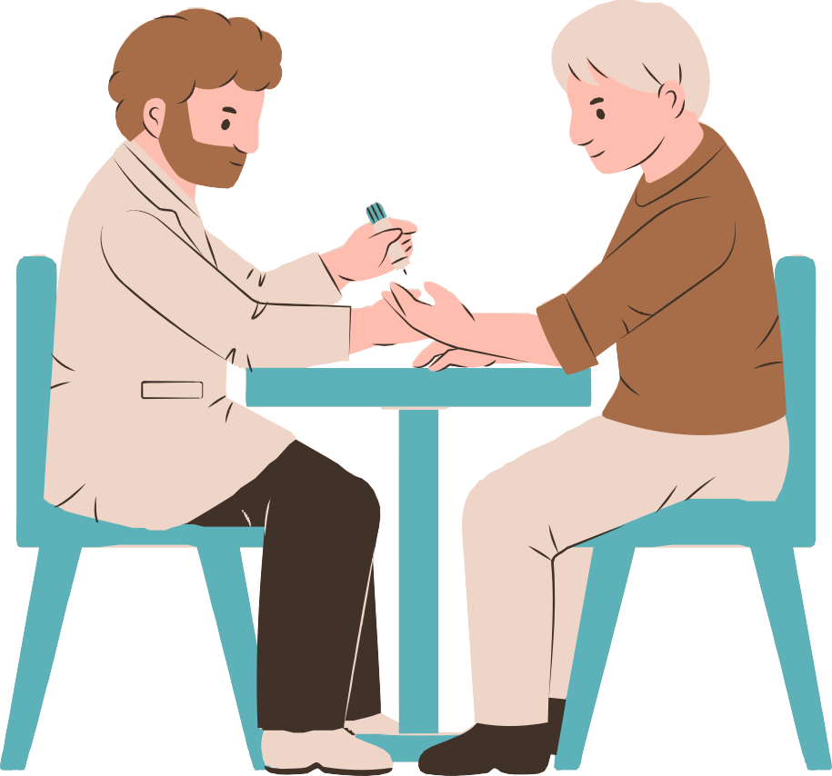
Datasets
We obtained two different data sets from kaggle which are given below. The first dataset had 2768 entries as processed https://www.kaggle.com/datasets/nanditapore/healthcare-diabetes
and the second had 4304 entries Diabetes_Dataset_With_18_Features

Slide 8
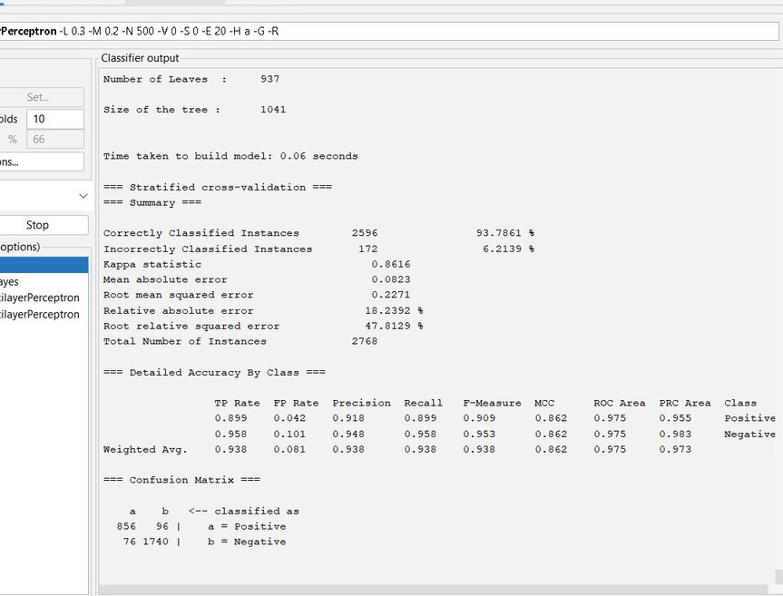
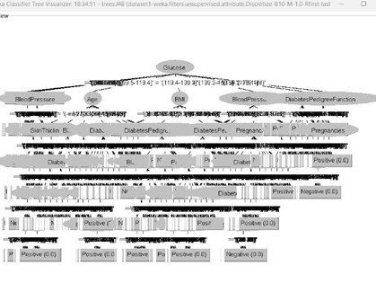
TESTING AND RESULTS in Weka program
A. Decision tree (Dataset 1 with 2768 entries)
training
The decision tree model’s results showed Time taken to build model: 0.06 sec and a correctly classified instance rate of 93.78%, with a precision, recall, and F-measure equal to 0.938. The confusion matrix resulted in 856 true positives (TP), 96 false negatives (FN), 76 false positives (FP), and 1740 true negatives (TN). Based on these numbers, the overall accuracy, calculated as (TP+TN)/(TP+FP+TN+FN), was found to be 0.9378.
testing
Time taken to build model: 0.03 sec, Total Number of Instances: 554 Correctly classified instances: 542 ,In correctly classified instances 12, Accuracy= correctly classified Instances/ Total number of instances in training set, Accuracy=542/554 = 0.978 TP=181 , FP= 10 , FN=2 , TN = 361

Slide 9

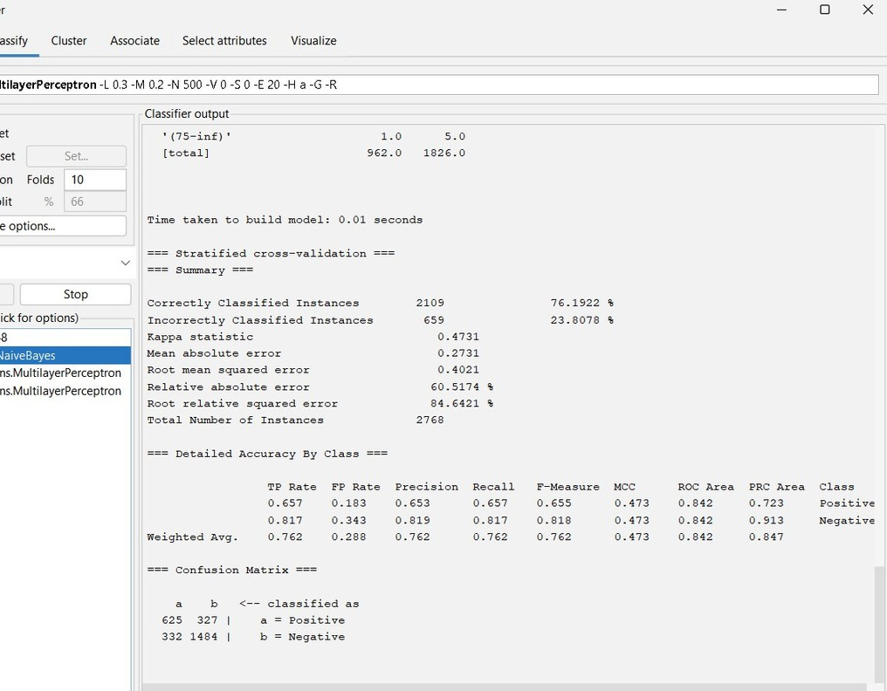
B. Naïve Bayes
test
Total Number of Instances: 554 Correctly classified instances: 422 In correctly classified instances 132
Accuracy= correctly classified Instances/ Total number of instances in data set Accuracy=422/554 = 0.7617
TP=117 , FP= 66 , FN=66 , TN = 305 Precision= TP/TP+FP = 117/554= 0.6393 Recall = TP/TP+FN=171/171+66 = 0.6393 F1 score= 2P*R/P+R = 0.6395
traning
The Naïve Bayes model’s results showed a correctly classified instance rate of 76.192%, with a precision, recall, and F-measure equal to 0.762. The confusion matrix resulted in 625 true positives (TP), 327 false negatives (FN), 332 false positives (FP), and 1484 true negatives (TN). Based on these numbers, the overall accuracy, calculated as (TP+TN)/(TP+FP+TN+FN), was found to be 0.7619.

Slide 10
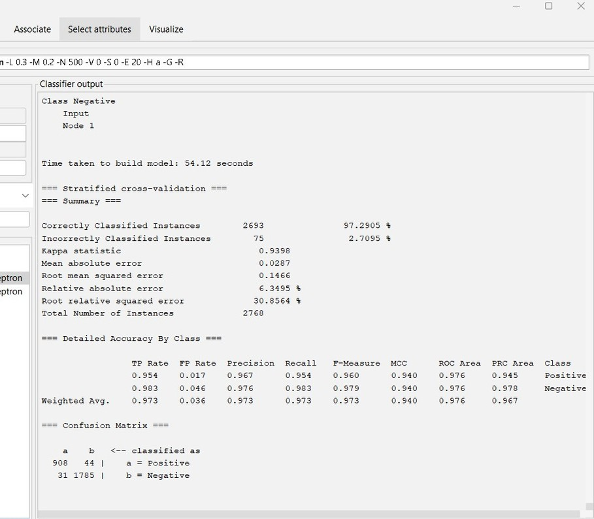
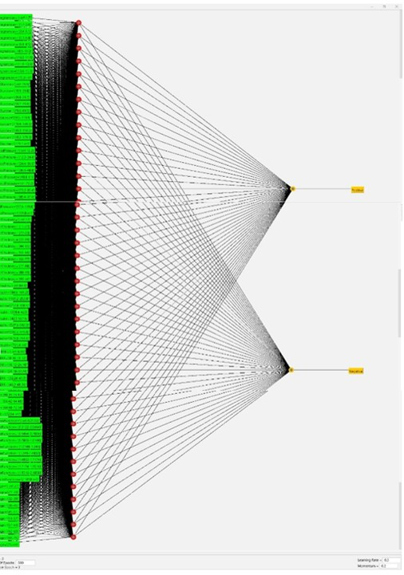
C. Neural network
testing
Total Number of Instances: 554 Correctly classified instances: 455 In correctly classified instances 99 Accuracy= correctly classified Instances/ Total number of instances in data set Accuracy=455/554 =0.8213 TP=128 , FP= 44 , FN=55 , TN =
327 Precision= TP/TP+FP = 128/128+44 = 0.7442 Recall = TP/TP+FN=128/128+55 = 0.6995
F1 score= 2P*R/P+R = 0.7211
Traning
The Neural network model’s results showed a correctly classified instance rate of 97.29%, with a precision, recall, and F-measure equal to 0.973. The confusion matrix resulted in 908 true positives (TP), 44 false negatives (FN), 31 false positives (FP), and 1785 true negatives (TN). Based on these numbers, the overall accuracy, calculated as (TP+TN)/(TP+FP+TN+FN), was found to be 0.9729.

Slide 11

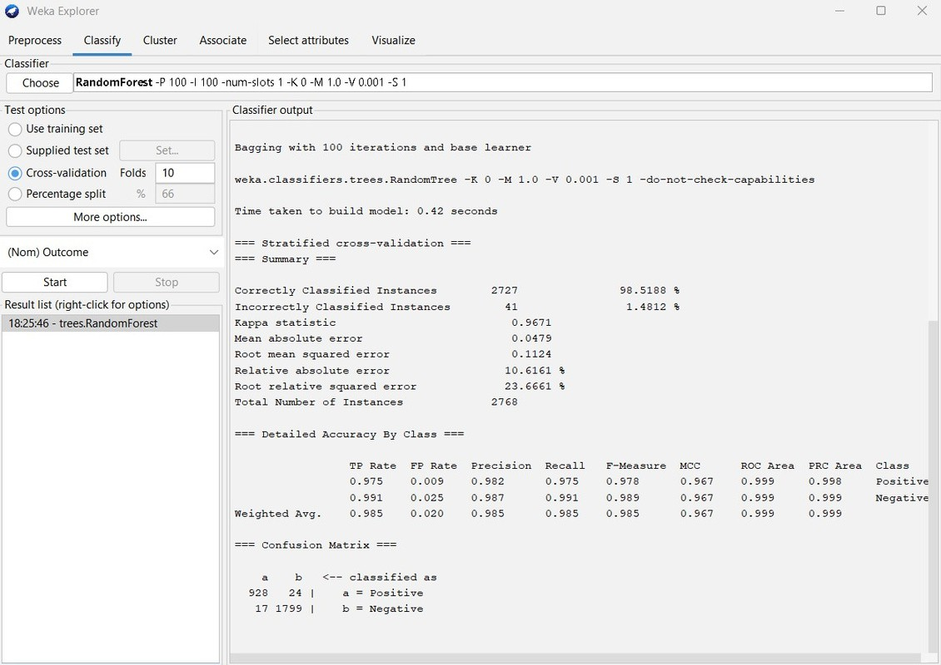
D. random forest
The random forest model’s results showed a correctly classified instance rate of 98.518% with a precision, recall, and F-measure equal to 0.985. The confusion matrix resulted in 928 true positives (TP), 24 false negatives (FN), 17 false positives (FP), and 1799 true negatives (TN). Based on these numbers, the overall accuracy, calculated as (TP+TN)/(TP+FP+TN+FN), was found to be 0.9851.

Slide 12
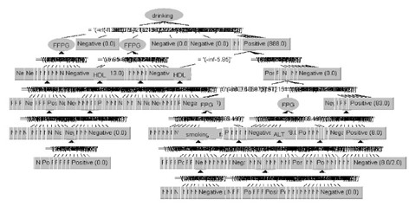
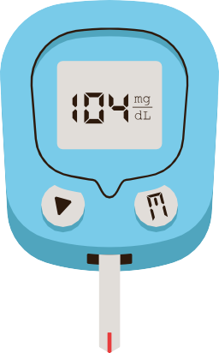
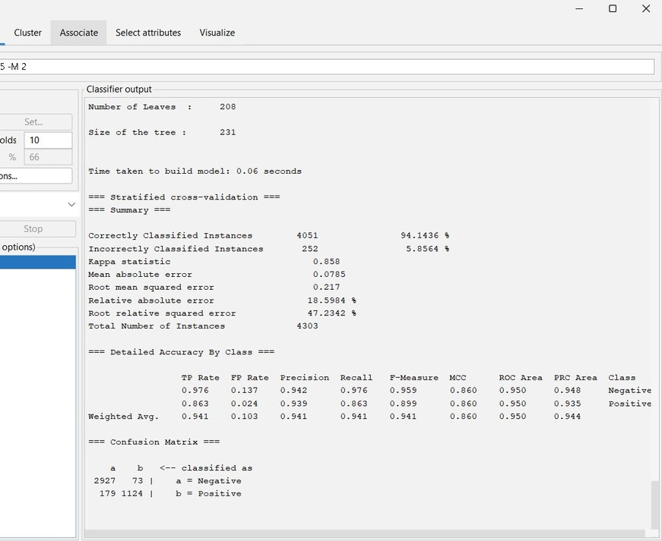

A. Decision tree
(Dataset 2 with 4304 entries)
The decision tree model’s results showed a correctly classified instance rate of 94.14, with a precision, recall, and F-measure equal to 0.941. The confusion matrix resulted in 2927 true positives (TP), 73 false negatives (FN), 179 false positives (FP), and 1124 true negatives (TN). Based on these numbers, the overall accuracy, calculated as (TP+TN)/(TP+FP+TN+FN), was found to be 0.9414.

Slide 13
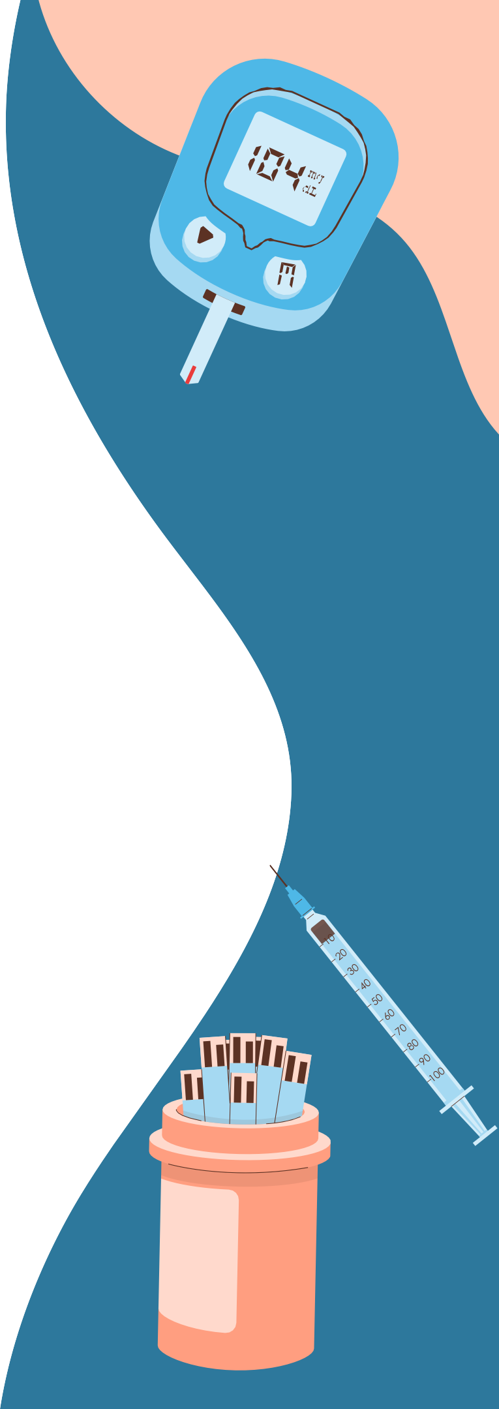
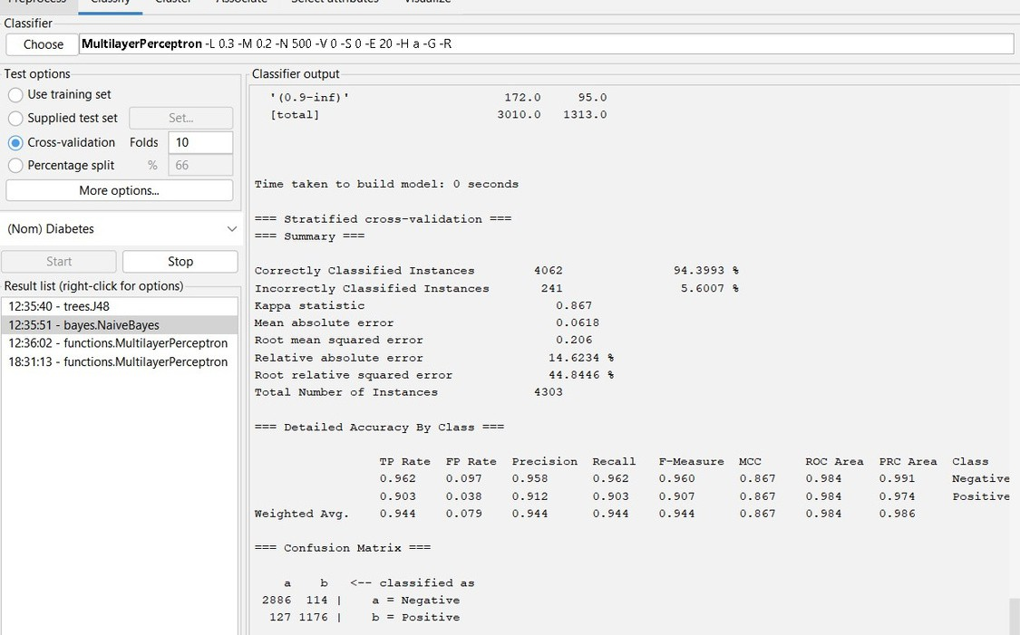
B. NAÏVE BAYES
The Naïve Bayes model’s results showed a correctly classified instance rate of 94.39%, with a precision, recall, and F-measure equal to 0.944. The confusion matrix resulted in 2886 true positives (TP), 114 false negatives (FN), 127 false positives (FP), and 1176 true negatives (TN). Based on these numbers, the overall accuracy, calculated as (TP+TN)/(TP+FP+TN+FN), was found to be 0.9439.

Slide 14

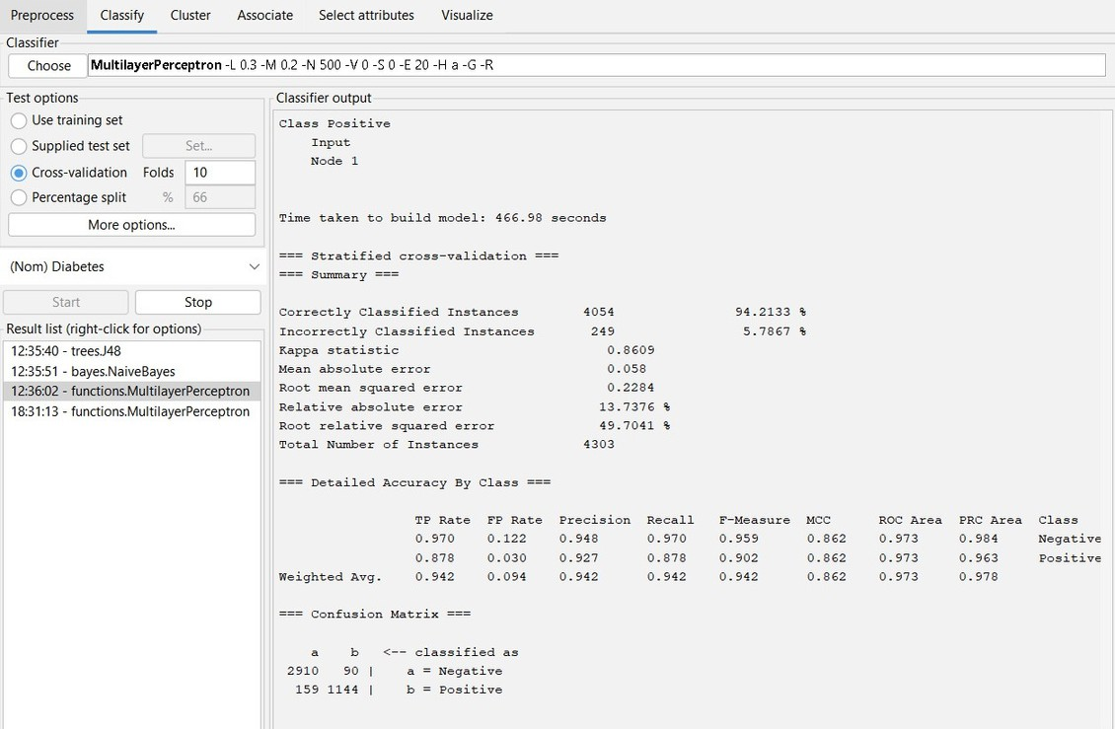
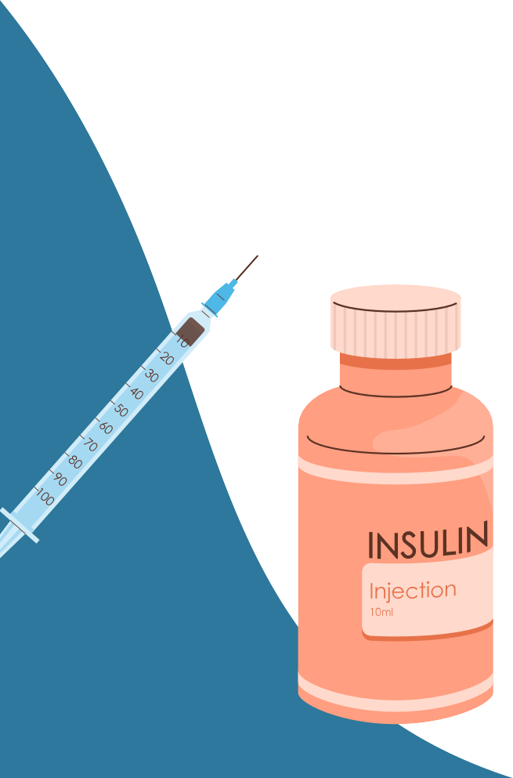
C. NEURAL NETWORK
The Neural network model’s results showed a correctly classified instance rate of 94.213%, with a precision, recall, and F-measure equal to 0.942. The confusion matrix resulted in 2910 true positives (TP), 90 false negatives (FN), 159 false positives (FP), and 1144 true negatives (TN). Based on these numbers, the overall accuracy, calculated as (TP+TN)/(TP+FP+TN+FN), was found to be 0.9421.

Slide 15
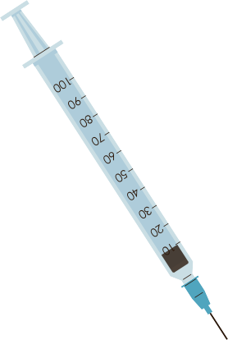
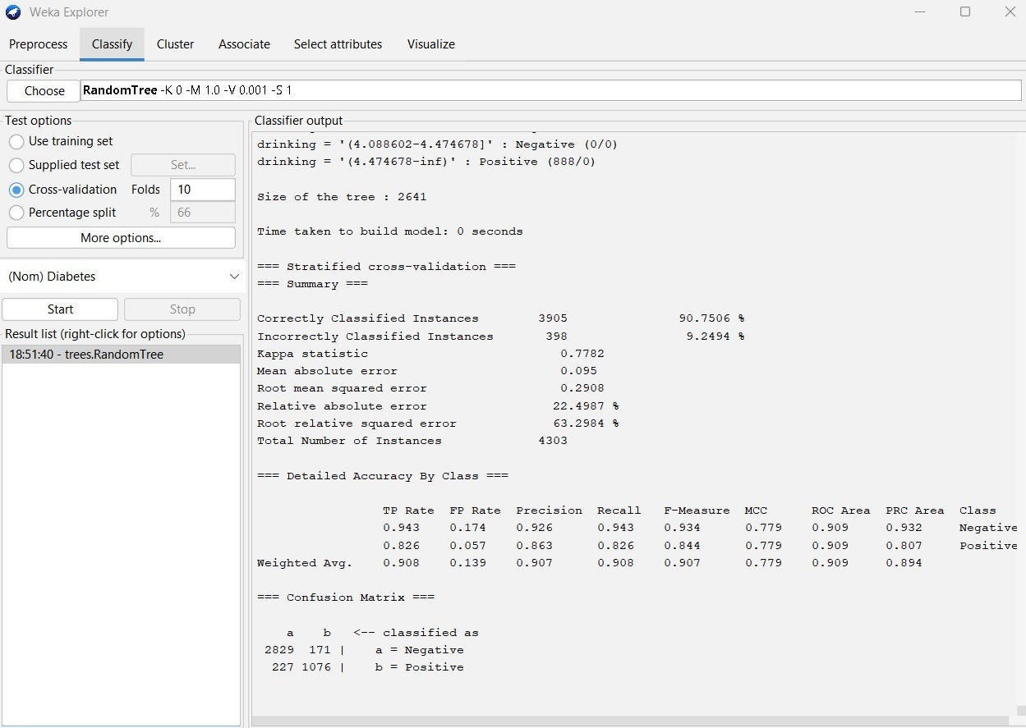
D. RANDOM FOREST
THE RANDOM FOREST MODEL’S RESULTS SHOWED A CORRECTLY CLASSIFIED INSTANCE RATE OF 90.750%, WITH A PRECISION, RECALL, AND F-MEASURE EQUAL TO 0.907. THE CONFUSION MATRIX RESULTED IN 2829 TRUE POSITIVES (TP), 171 FALSE NEGATIVES (FN), 227 FALSE POSITIVES (FP), AND 1076 TRUE NEGATIVES (TN). BASED ON THESE NUMBERS, THE OVERALL ACCURACY, CALCULATED AS (TP+TN)/(TP+FP+TN+FN), WAS FOUND TO BE 0.9075.

Slide 16

Based on our results, the random forest algorithm achieved the highest accuracy on dataset one at 98.518%. For dataset two, the naive Bayes algorithm was most effective, reaching an accuracy of 94.39%.

Slide 17
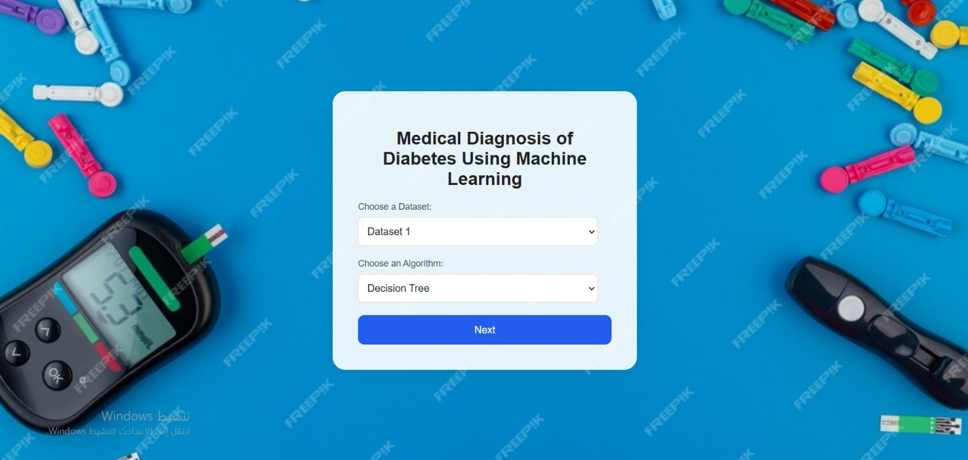
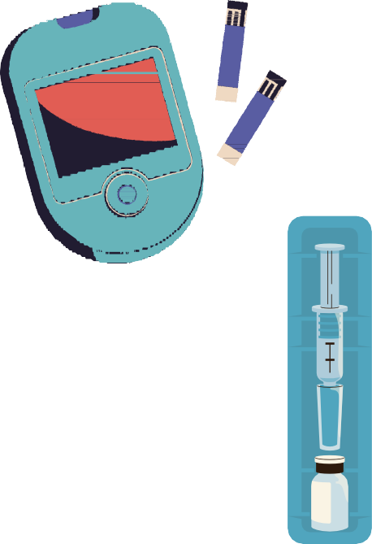
A WEB INTERFACE FOR DIABETES DIAGNOSIS
WE CREATED A USER WEBSITE INTERFACE TO MAKE OUR PROJECT MORE PRACTICAL AND ACCESSIBLE, ENABLING USERS TO TEST FOR A POSSIBLE DIABETES DIAGNOSIS.
PAGE 1

Slide 18

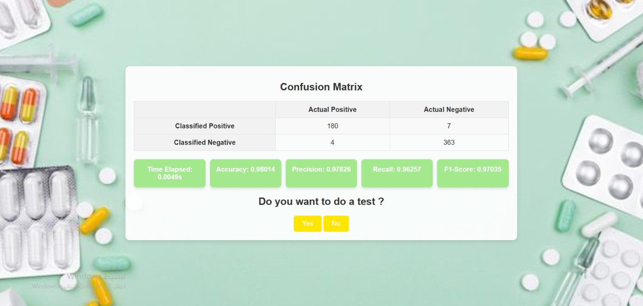
PAGE 2

Slide 19
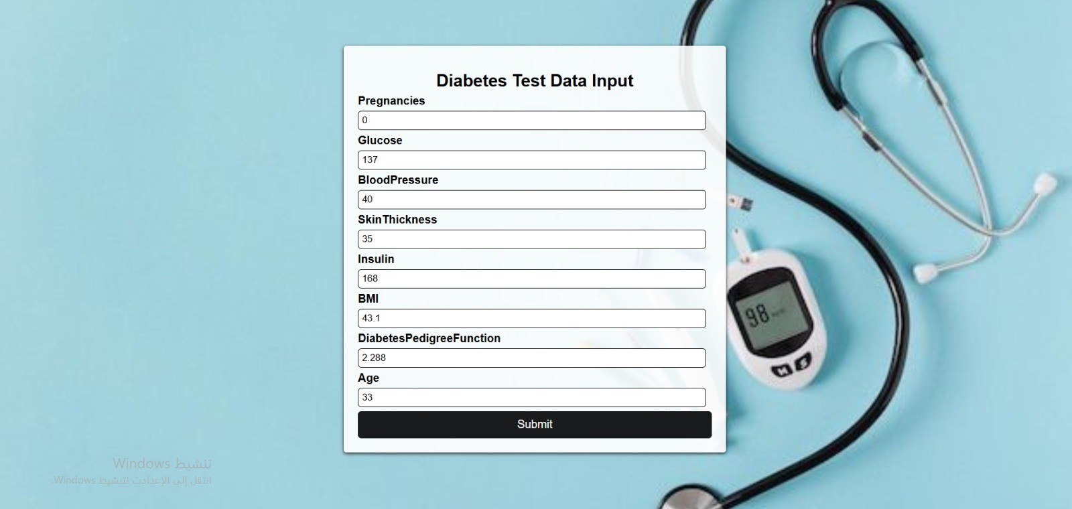

PAGE 3 : IF THE USESR WANT TO DO A TEST FOR DATASET 1

Slide 20


PAGE 4

Slide 21
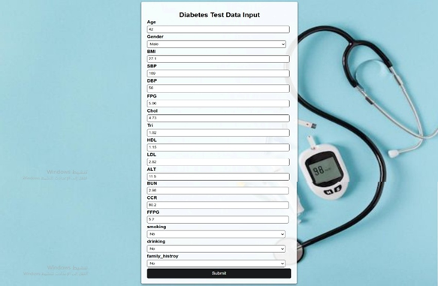
PAGE 3 : IF THE USESR WANT TO DO A TEST FOR DATASET 2

Slide 22

PAGE 4

Slide 23
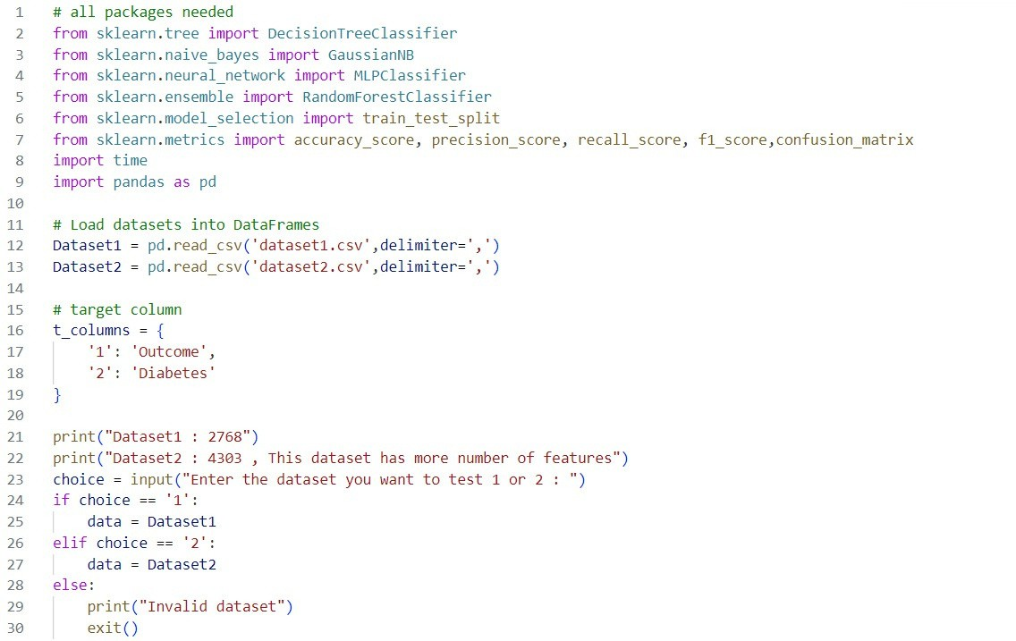

3. PYTHON CODE
WE IMPORT THE NECESSARY LIBRARIES, SUCH AS SKLEARN FOR MACHINE LEARNING MODELS AND METRICS, AND PANDAS FOR HANDLING DATASETS. AND TO MAKE THE DATA READY FOR ANALYSIS WE IMPORT THE TWO FILES AS DATASET 1 AND DATASET 2 FROM LOCAL CSV FILES USING THE METHOD PD.READ_CSV().

Slide 24
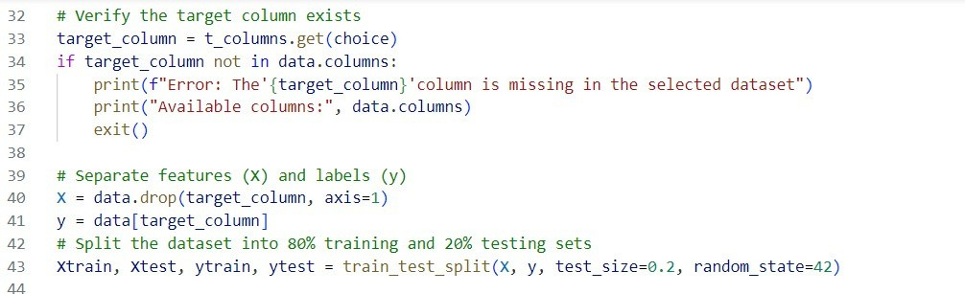
THE TARGET COLUMN NAME IS OBTAINED BY USING THE CHOICE OF THE USER AS THE KEY FOR ACCESSING THE VALUE IN THE DICTIONARY, T_COLUMNS. IF THE GIVEN TARGET COLUMN IS NOT IN THE SELECTED DATASET, WE DISPLAY WHICH COLUMNS ARE AVAILABLE AND THEN THE PROGRAM CEASES OPERATION.

Slide 25
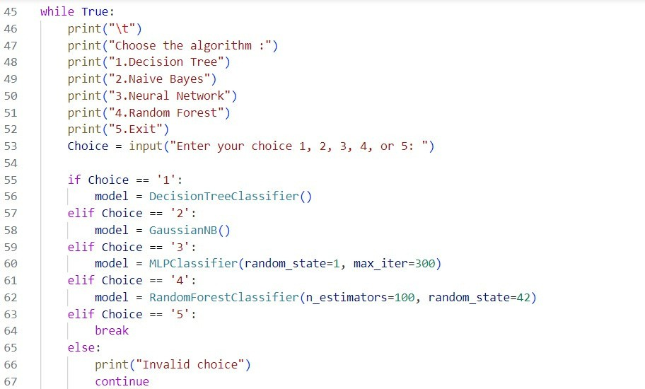
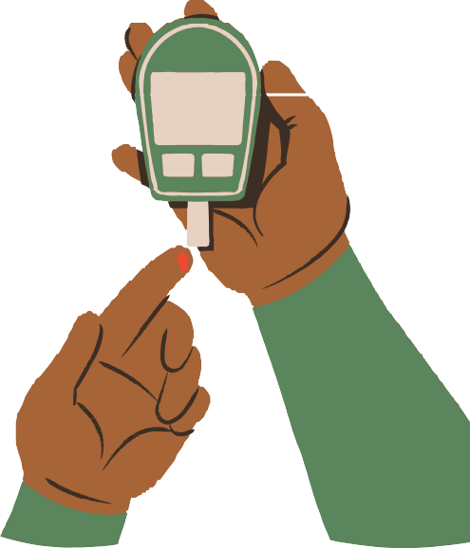
A WHILE TRUE LOOP ENSURES THE USER CAN REPEATEDLY CHOOSE AN ALGORITHM UNTIL THEY DECIDE TO EXIT AND BASED ON THE USER'S INPUT, THE APPROPRIATE MACHINE LEARNING MODEL IS INSTANTIATED

Slide 26
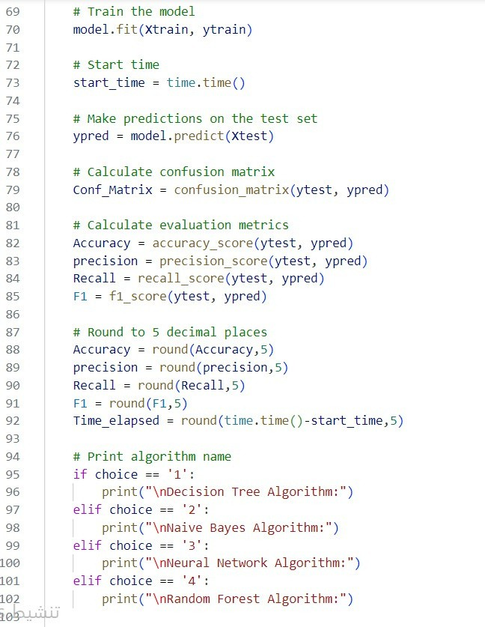
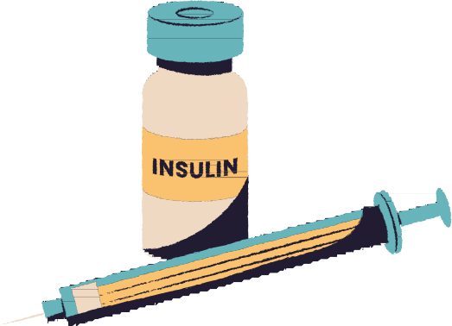
WE TRAINED THE PREVIOUSLY SELECTED MACHINE LEARNING MODEL USING THE TRAINING DATA (FEATURES IN XTRAIN AND LABELS IN YTRAIN). THIS WAS WHERE THE MODEL LEARNED THE PATTERNS IN THE DATA. AND WE RECORDED THE CURRENT TIME BEFORE THE PREDICTION PROCESS STARTED, USED FOR MEASURING THE TIME IT TAKES TO MAKE A PREDICTION. AND WE USED THE TRAINED MODEL TO PREDICT THE LABELS (YPRED) FOR THE TEST DATASET'S FEATURES (XTEST).

Slide 27
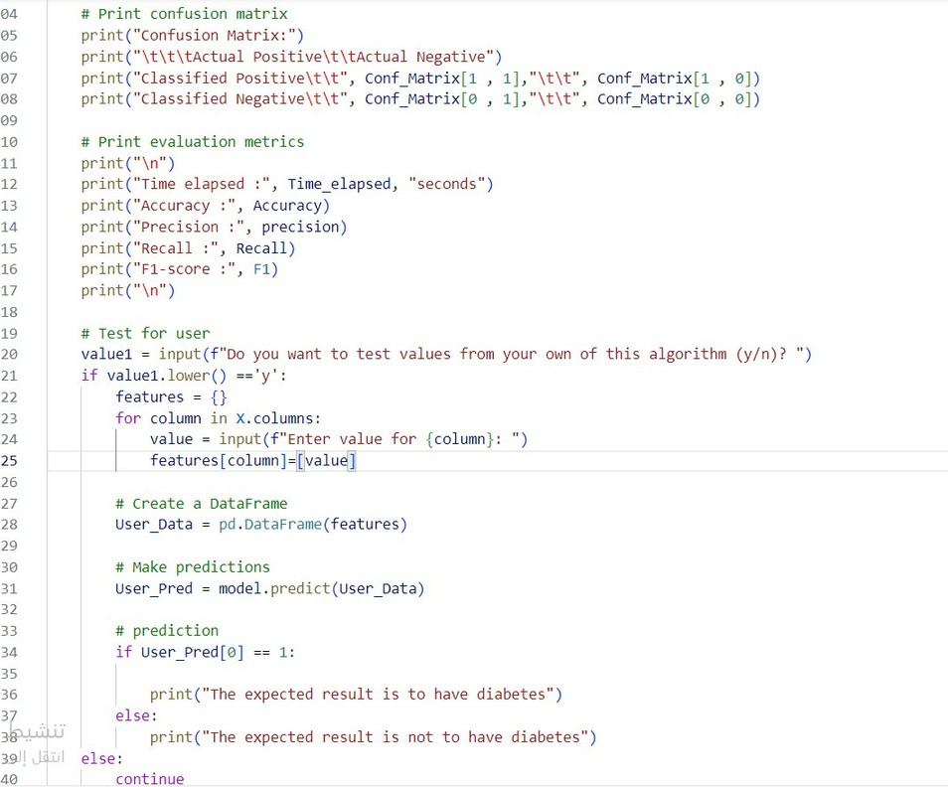
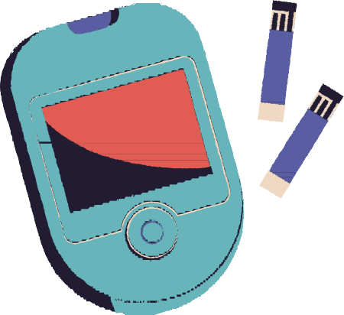
WE ASK THE USER IF THEY WANT TO INPUT NEW VALUES. AND IF THE USER CHOICE YES, WE PROMPT THEM TO ENTER VALUES FOR EACH COLUMN IN THE DATA. THEN WE CREATE A NEW DATAFRAME USING THE VALUES PROVIDED BY THE USER. THEN WE USE THE TRAINED MODEL TO PREDICT THE OUTCOME BASED ON THE USER INPUT. AND PRINT WHETHER THE EXPECTED RESULT INDICATES DIABETES OR NOT.

Slide 28
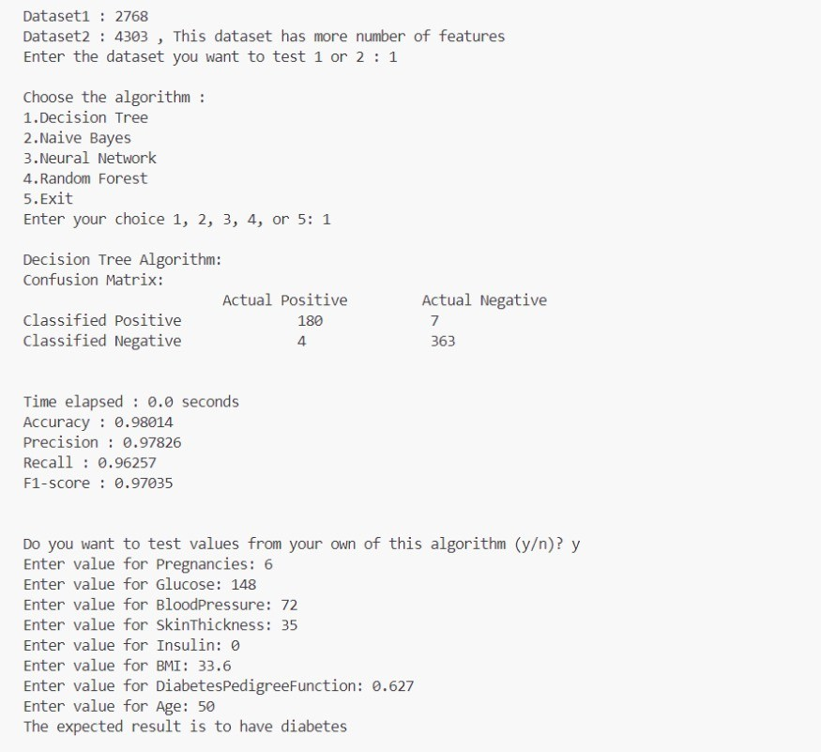
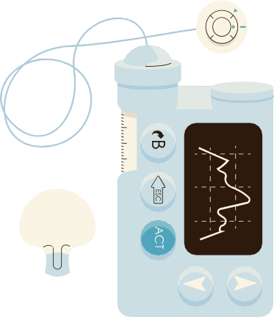
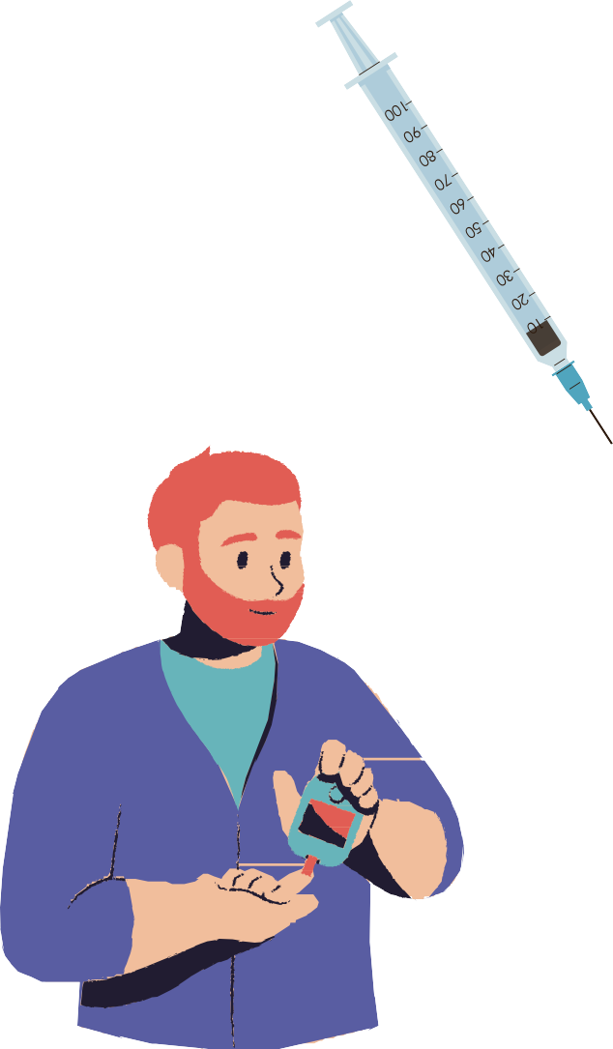
HERE IS AN EXAMPLE OF WHAT THE OUTPUT LOOKS LIKE WHEN WE RUN THIS CODE

Slide 29
